Slide 1
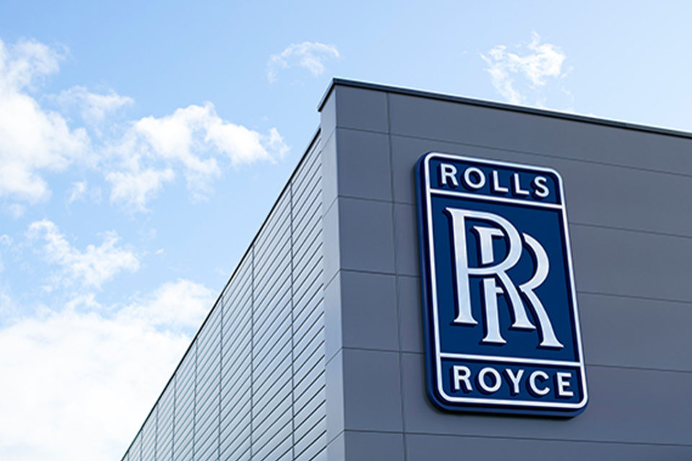
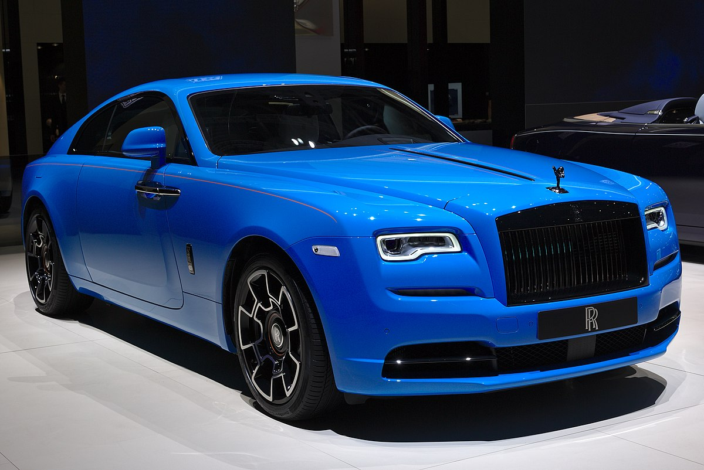
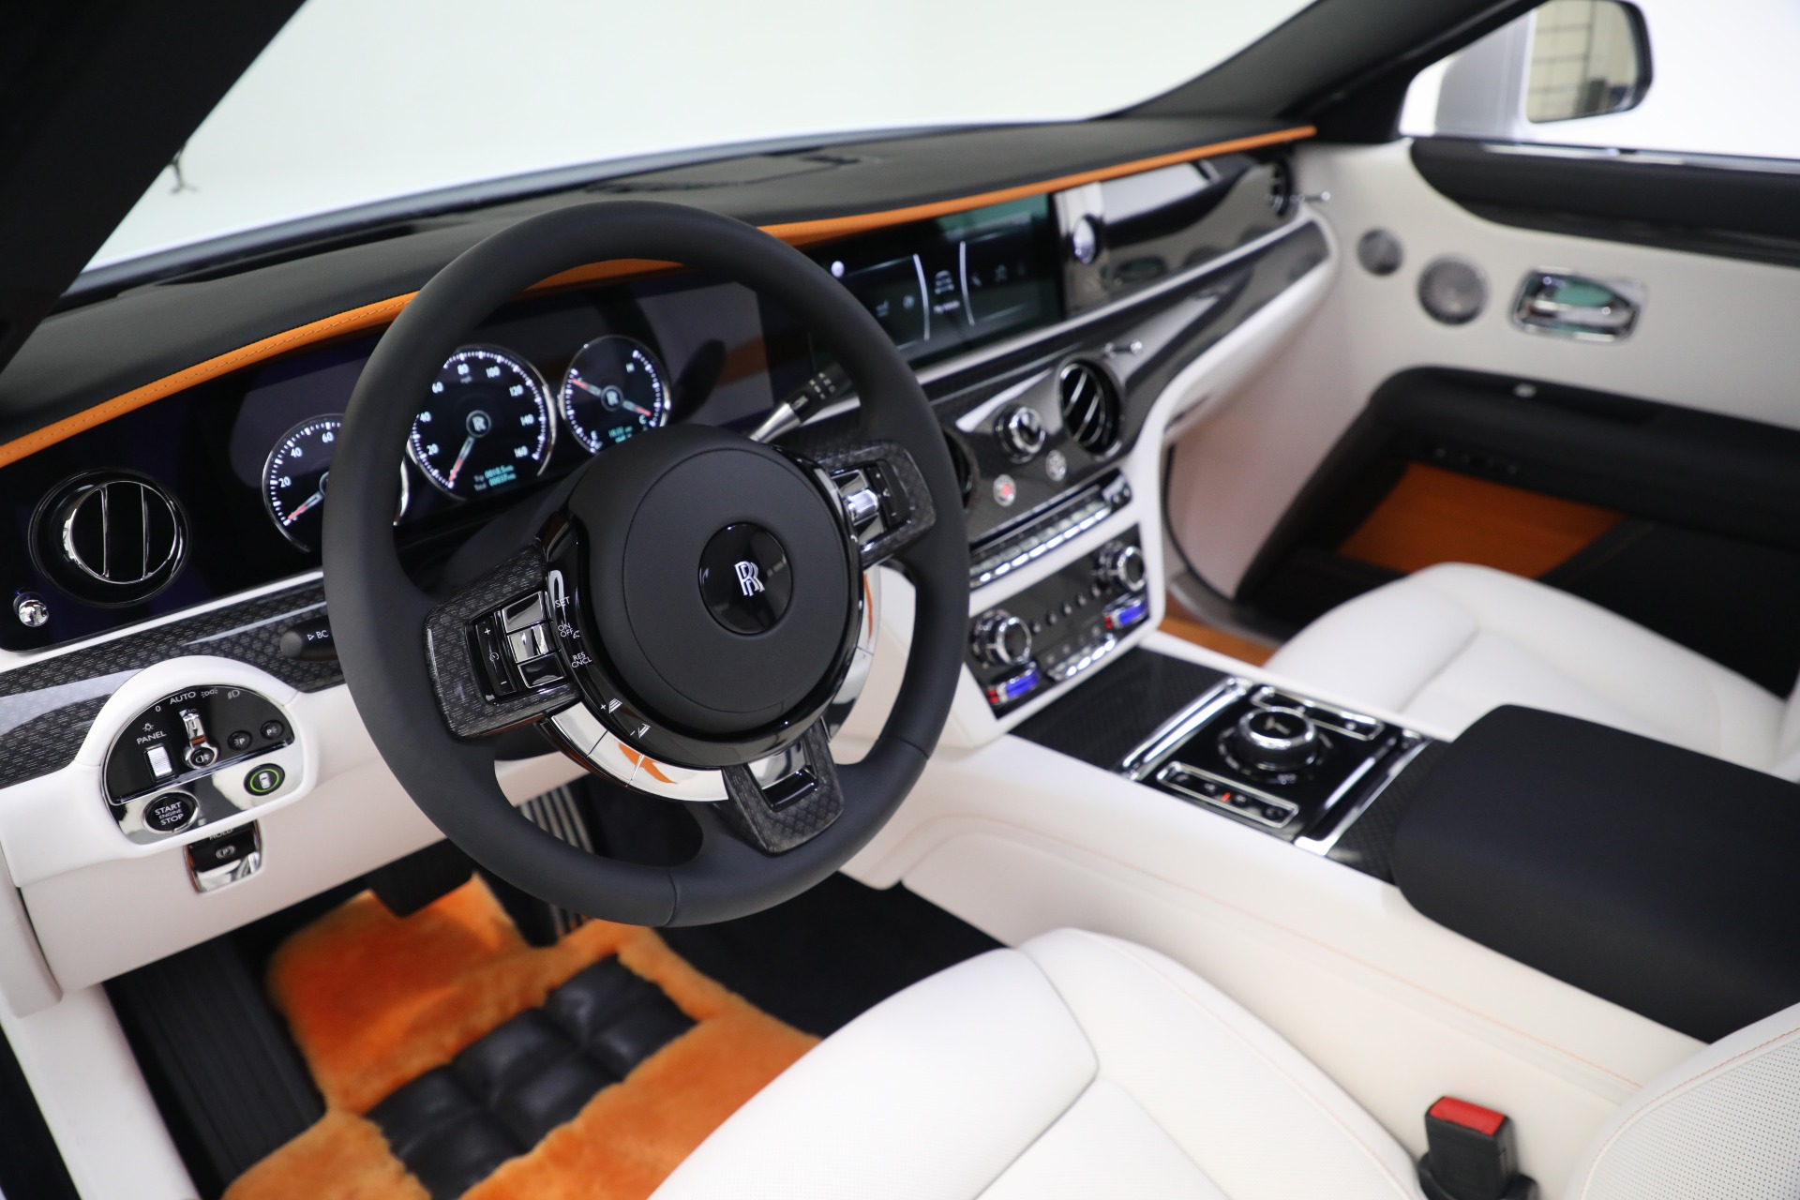


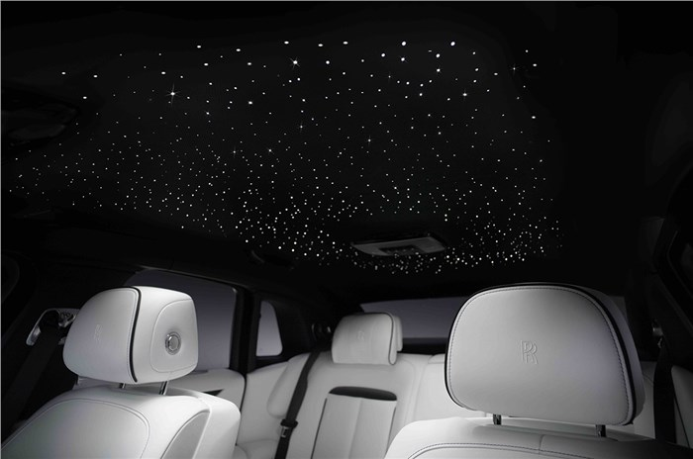
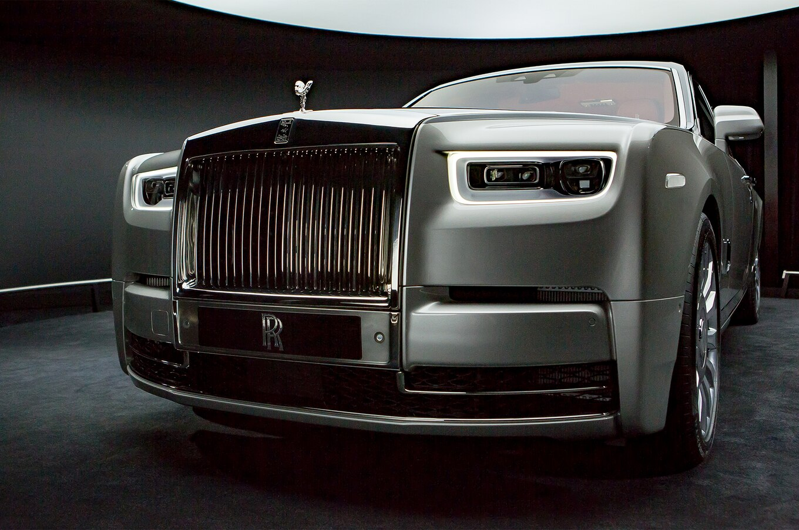
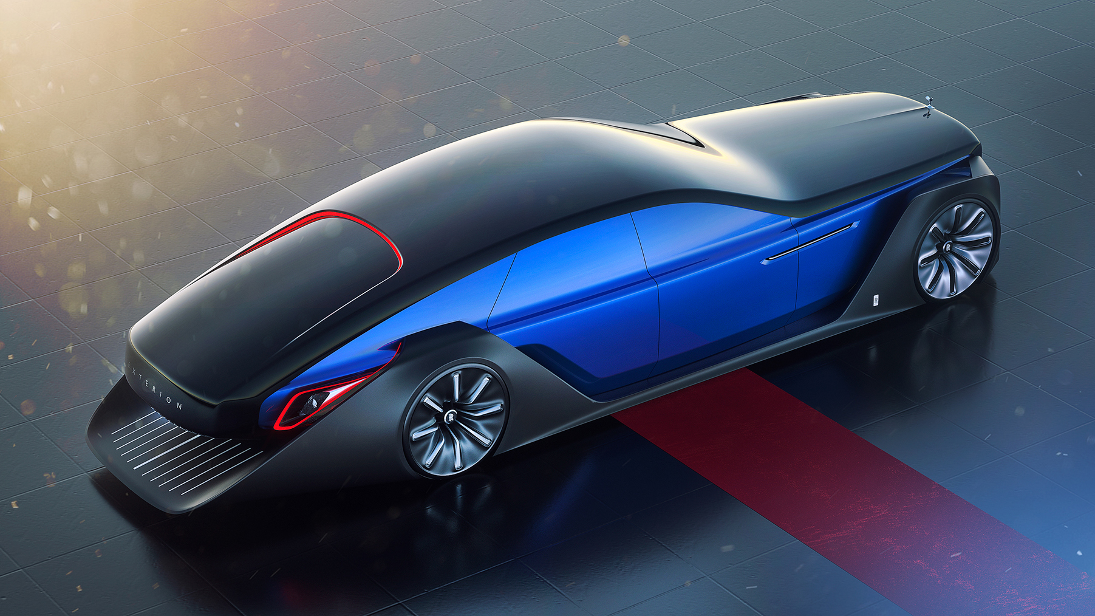
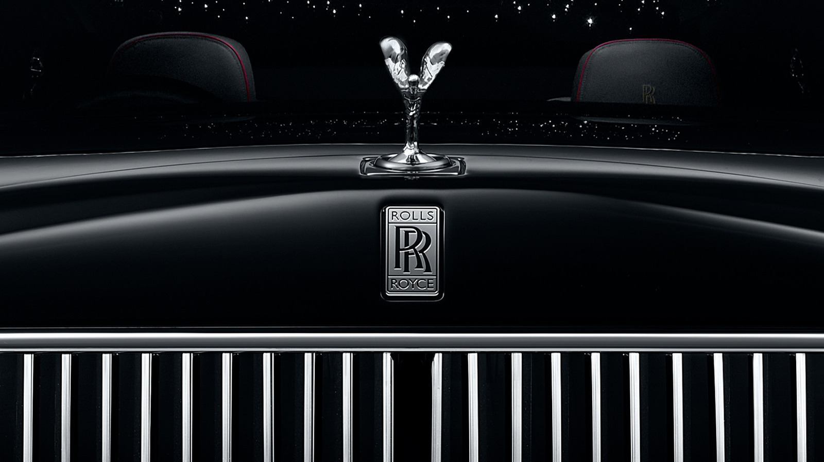
Rolls
Royce
Showroom
Made BY:- Yadav Rohit

Slide 2
Rolls
Royce
INTRODUCTION
Made BY:- Yadav Rohit
One of the key features that sets Rolls-Royce apart from other luxury car brands is its customization options.
Rolls-Royce offers an extensive range of custom-made services, allowing customers to create a car that is uniquely tailored to their individual tastes and preferences.
This level of customization allows customers to create a car that is a true reflection of their personality and style, making it a highly sought-after status symbol.
Showroom

Slide 3
INTRODUCTION
One of the key features that sets Rolls-Royce apart from other luxury car brands is its customization options.
Rolls-Royce offers an extensive range of custom-made services, allowing customers to create a car that is uniquely tailored to their individual tastes and preferences.
This level of customization allows customers to create a car that is a true reflection of their personality and style, making it a highly sought-after status symbol.
METHODS
1.View Car
2.Buy Car
3.Customize Car
4.Service Car

Slide 4
METHODS
1.View Car
2.Buy Car
3.Customize Car
4.Service Car
Types
1.Type Of Car
2.Type Of Customization
3.Type Of Service

Slide 5
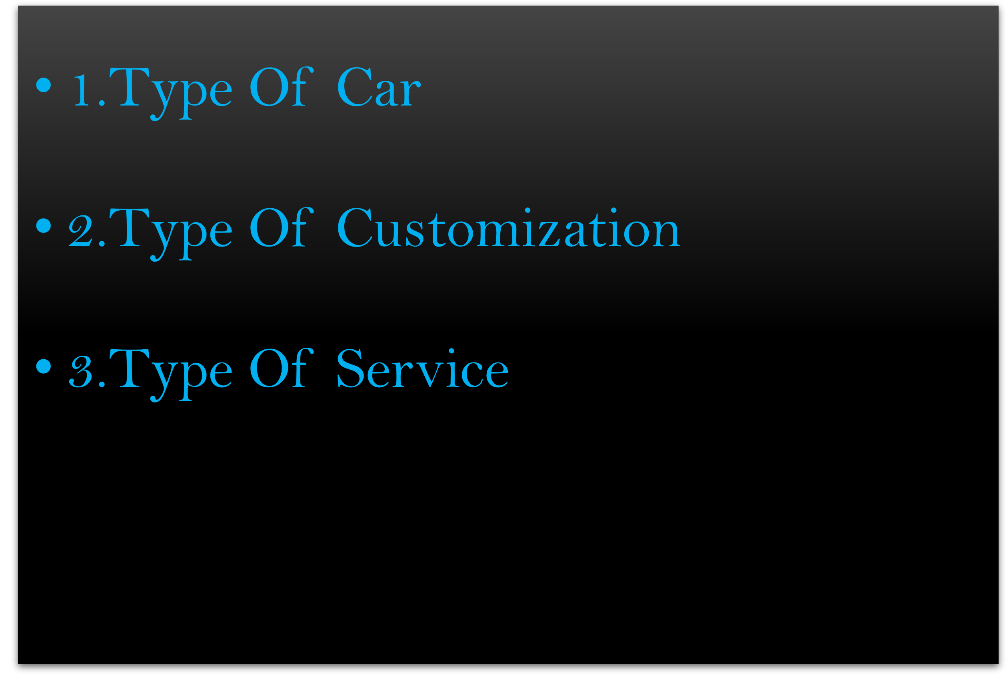
Types
EXAMPLE
MODEL: GHOST
EXTERIOR COLOR: BLUE
INTERIOR: LATHER
ADDITIONAL OPTIONS: NIGHT VISION

Slide 6




EXAMPLE
MODEL: GHOST
EXTERIOR COLOR: BLUE
INTERIOR: LATHER
ADDITIONAL OPTIONS: NIGHT VISION
What Classes Are Use?

Slide 7
Which Concepts Are Use ?
FUTURE OF CUSTOMIZATION
Rolls-Royce is exploring the use of digital design tools and technologies to enhance the customization process
Rolls-Royce is exploring the use of sustainable materials in its customization options, such as vegan leather and recycled materials.
Rolls-Royce is researching the use of artificial intelligence to personalize the driving experience
Future customization options will continue to evolve and adapt to changing customer preferences and technological advancements

Slide 8
FUTURE OF CUSTOMIZATION
Rolls-Royce is exploring the use of digital design tools and technologies to enhance the customization process
Rolls-Royce is exploring the use of sustainable materials in its customization options, such as vegan leather and recycled materials.
Rolls-Royce is researching the use of artificial intelligence to personalize the driving experience
Future customization options will continue to evolve and adapt to changing customer preferences and technological advancements

Slide 9


Slide 10
Cars
Customization
Services
GHOST
CULLINAN
DAWN
PHANTOM
WRAITH
EXTERIOR COLOR
DIAMOND BLACK
JUBILEE SILVER
ARCTIC WHITE
INTERIOR
LEATHER BLACK
WOOD TRIM
ADDITIONAL OPTIONS
PANORAMIC SUNROOF
REAR SEAT ENTERTAINMENT
NIGHTVISION
OIL CHANGE
BRAKE INSPECTION
TIRE ROTATION
PPF
ENGINE CHECKING
ALL OVER SERVICE

Slide 11
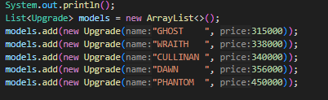
Array List
Array List use for store Car Name, Exterior colour etc.

Slide 12
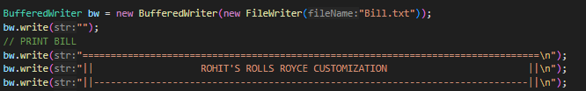
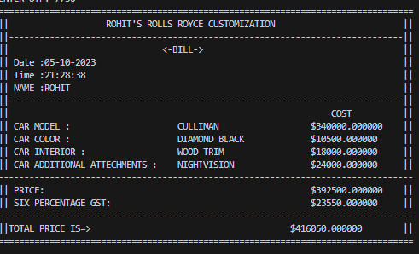
File Reader And File Writer
File Writer is Use to Print Bill in TXT file and Reader use for Read.

Slide 13
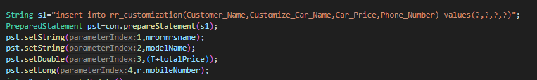
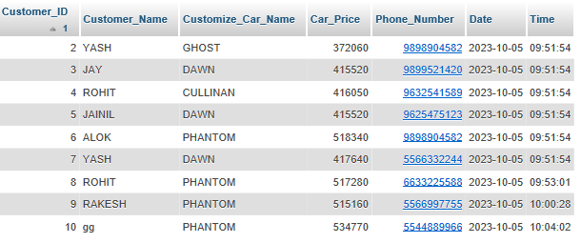
JDBC
JDBC use for Run queries and Store data in Database

Slide 14
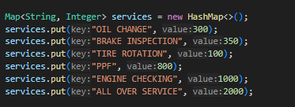
Hash Map
Hash Map is Use for Store Service and it Cost

